Slide 1
E-bay Website Testing Project Manual + Automation Testing
Under Guidance of Mrs. Vaishali Sonawane Mam 19/08/2025

Slide 2
INTRODUCTION
eBay is a global e-commerce company known for its online marketplace where individuals and businesses can buy and sell. Founded in 1995
This project focuses on testing the E bay Website to ensure its functionality, usability, and reliability.
Both Manual Testing and Automation Testing (Selenium + TestNG) were performed.
The scope included login, product search, cart management, categories, profile, and language settings.

Slide 3
Responsibilities
Collected requirements and created module-wise breakdown.
Designed Test Plan & Test Cases.
Executed manual testing and logged defects in Jira.
Automated test cases using TestNG with POM and Data Driven Testing.
Prepared defect reports and test analysis.

Slide 4
OVERVIEW
APPLICATION TYPE
E-commerce web platform
APPROACH
Manual Testing + Automated Testing.
TOOLS USED
Selenium WebDriver, TestNG, Excel, Jira
DELIVERABLES
Test Plan, Test Cases, Automation Scripts, Defect Reports, Test Analysis Report.

Slide 5
MODULES
Module 1: User Login
Handles user authentication by verifying valid and invalid login attempts. Provides access to the user profile after successful login.
Module 2: Product Search & Filter
Allows users to search products using keywords and apply sorting options such as price (low–high) and relevance.
Module 3: Cart Management
Enables users to add items to the cart, update quantities, and remove products before checkout.

Slide 6
Module 4: Profile Management
Allows users to update personal details such as name, address, and other profile information.
Module 5: Shop by All Category
Displays a complete list of product categories with smooth scrolling and easy accessibility for users.
Module 6: Shop by Specific Category
Enables navigation to a chosen category and ensures that only relevant products under that category are displayed.

Slide 7
Module 7: Product Details Page
Displays detailed product information including description, price, images, and reviews. Also provides the option to add products to the cart.
Module 8: Language & Country Change
Allows users to change language and country preferences from settings. Ensures that the selected preferences persist after logout and across different devices such as mobile.

Slide 8
Defects
While executing the test cases, at certain points some application fields and functionalities did not work as expected. These deviations from the expected results were identified as defects. I have developed Defect Reports to capture the details such as defect ID, summary, test case, severity, priority, screenshots, and status.

Slide 9
DEFECT IDENTIFIER : DI_001
Defect Summary | Expected Result : when filtering products based on the price (max $40), it is also showing products with higher price, Actual Result: should only show products with total price(price + shipping) according to filtered condition
Test Id | TC_SR_04
Test case name | Price filter
Module name | Search & Filter
Reproducible | Yes : open e bay website – select a category(wrist watch) – add price filter(max 40$)
Severity | Medium(impacts user experience)
Priority | High(filtering is a key function)
Raised by | Raniya(Tester)
Assigned To | Team Lead
Date of assignment | 18-08-2025
Status | Open
Snap shot
Fixed by | -
Date of fixing | -
Approvals | QA Lead / Project manager

Slide 10
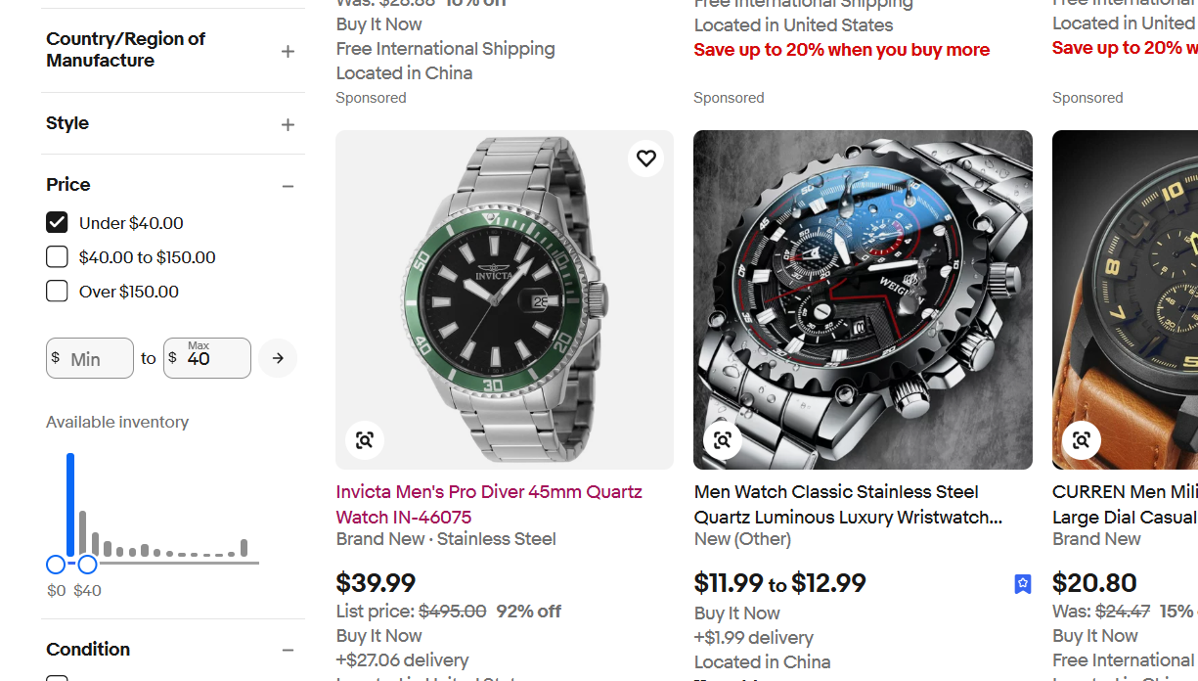

Slide 11
DEFECT IDENTIFIER : DI_002
Defect Summary | Expected Result: when user clicks Shop by category, it should display the list of all the categories and it should be perfectly scrollable. Actual Result: all categories are displayed, but cannot properly scroll the category list
Test Id | TC_AC_02
Test case name | Validate categories list loads and scroll
Module name | All Category
Reproducible | Yes – open e-bay website – click on shop by categories
Severity | Medium(affects usability, but not effecting core function)
Priority | Medium(should be fixed soon as it effect user experience)
Raised by | Raniya(Tester)
Assigned To | UI developer/Team Lead
Date of assignment | 18-08-2025
Status | Open
Snap shot
Fixed by | -
Date of fixing | -
Approvals | QA Lead / Project manager

Slide 12
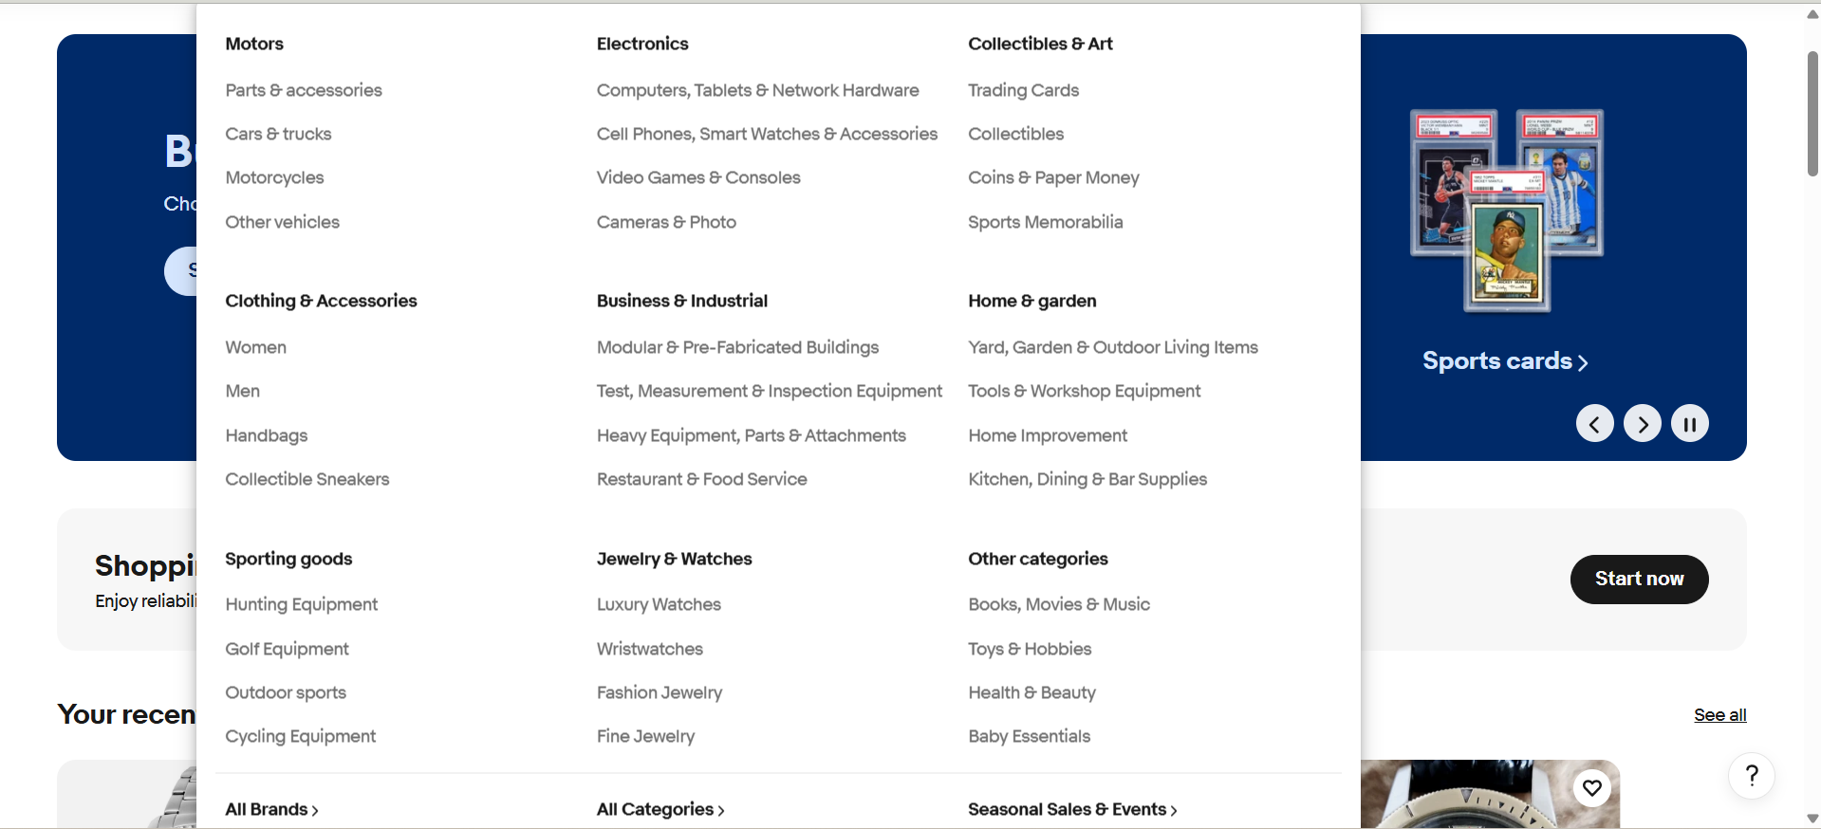

Slide 13
Challenges
Handling dynamic web elements during automation.
Language change feature missing on mobile view.
Experience
Understood end-to-end testing life cycle.
Practiced manual + automation testing together.
Gained hands-on experience with Jira for defect tracking.
Improved confidence in TestNG with POM & Data Driven Testing.

Slide 14
Thank you

